Slide 1
To DO ******* HW I am collecting
Take out Water For Elephants
none

Slide 2
Standards/Objective
Performance Objective(s)
In order to justify written arguments that support claims in an analysis of substantive texts, using valid reasoning and relevant and sufficient evidence students will create outline based on the essay that received a score of 9
Standard(s)
Cite strong and thorough textual evidence to support analysis
Determine two or more central ideas of a text and analyze their development over the course of the text

Slide 3
Work Session
WARMUP: Read and annotate Water For Elephants
THEY DO:
Groups of 4: Students will analyze and score anchor essays based on AP rubric
Whole Group: We will discuss the scores and groups will justify the scores given using the fish bowl strategy
Students will publish toulmin model and Thesis statement to website

Slide 4
Parts of Toulmin model
Claim: the position or claim being argued for; the conclusion of the argument.
Grounds/Data: reasons or supporting evidence that bolster the claim.
Warrant: the principle, provision or chain of reasoning that connects the grounds/reason to the claim.
Backing: support, justification, reasons to back up the warrant.
Rebuttal/Reservation: exceptions to the claim; description and rebuttal of counter-examples and counter-arguments.
Qualification: specification of limits to claim, warrant and backing.

Slide 5
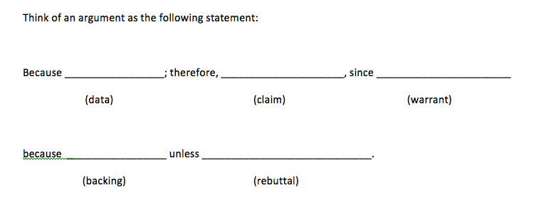
Toulmin Model
For example: Jane is a medical student; therefore she is probably smart since all medical students are smart because you have to take exams to be admitted to medical school unless she was admitted because her mother is a dean.

Slide 6
HW: FORMATIVE ASSESSMENT
Individually: compose Toulmin statement using teacher provided template
Individually: compose a thesis statement using teacher provided template

