Slide 1
9th Literature & Composition
Dr. Attis

Slide 2
Agenda - 8/3/16
Teacher Introduction
Syllabus Review
Will assign seats next period
Student Leader Opportunity
Technology Slip
Google Classroom
Download app
Sign up with aps username and pw lunch numberaps
Remind 101
Class website
Save as a favorite
HW

Slide 3
Dr. Attis BIO

Slide 4
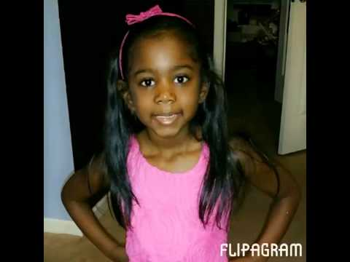
My Family

Slide 5
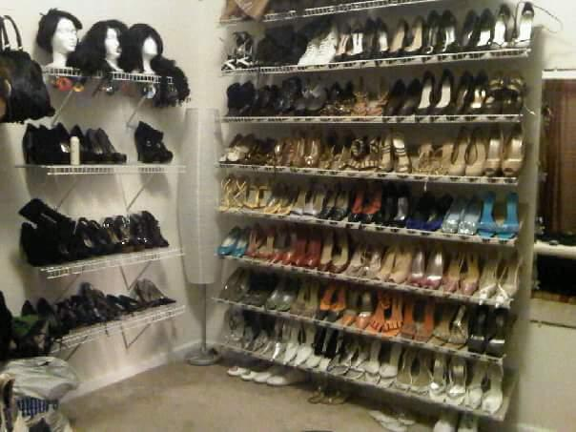
My Obsession

