Slide 1
Rhetorical Strategies Review
Dr. Attis 1b
Lauren Wells

Slide 2
All Mixed Up | Normal
10 | 10
20 | 20
30 | 30
40 | 40

Slide 3
Imagine this: A couple’s daughter is called to testify in a trial between her father and mother. She states: “They were not the happiest couple. The first time I caught him cheating it was so traumatizing. I didn’t want to believe my father would betray my mother like that. I went to therapy to release all the pain that was building up inside of me.” What is this an example(s) of?

Slide 4
“They were not the happiest couple” is an example of a Litotes because she didn’t want to slander her parents and could’ve said they were very unhappy. “I went to therapy to release all the pain that was building up inside of me” is an example of Catharsis because finding out her dad cheated on her mom was a tragedy and she wanted to be relieved of the pain.

Slide 5
What is this an example(s) of? I was talking to my friend and she was telling me about a poster she read and it said “War is peace. Freedom is slavery and ignorance is strength.” She told me she agreed with what the message was conveying, I told her that her comments on politics are not useless.

Slide 6
Loaded Statement and Litote because it is using descriptive words that evoke emotion and it uses an understatement to add emphasizes on the idea.

Slide 7
What does the following describes? Another character in a story who contrasts with the main character, usually to highlight one of their attributes. Wording that attempts to influence an audience by using appeal to emotion or stereotypes
Colloquial and Propaganda
Foil and Loaded Statement
Catharsis and Litotes

Slide 8
B.

Slide 9
The following is an example(s) of? What am I gonna buy with only $5M?

Slide 10
Litotes and Colloquial. The word only implies that $5M is a small amount and the word gonna is slang

Slide 11
Soft Drink, Coke, Pop, Soda are all examples of

Slide 12
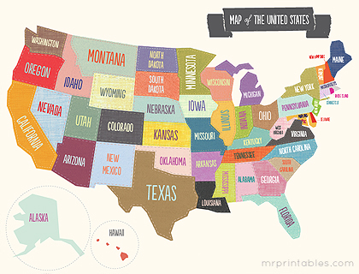
Colloquialism

Slide 13
What Litotes would you use if you got to the airport and found out your flight was delayed? A. Is there an alternative flight to New York? B. Where is the nearest bar? C. I am not a little upset

Slide 14
The correct answer is C because it’s an alternative way of saying you are very upset.

Slide 15
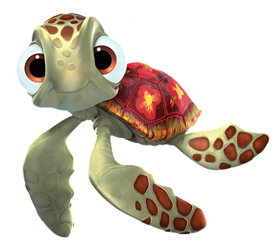
Who would be the foil character of Nemo’s dad Marlin? (Think about the characters in the movie and his relationships with them)
Nemo
Dory
Squirt

Slide 16
Dory would be Marlin’s foil because Marlin is cautious, anxious and protective while Dory is naïve, forgetful and childish.

Slide 17
What is this an example of?

Slide 18
Propaganda

